Slide 1
Single-Source Shortest Paths

Slide 2
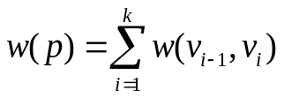
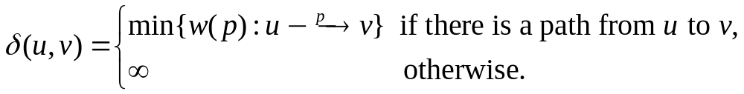
Shortest Paths—Notions Related
Given a weighted, directed graph G = (V, E; w), the weight of path p = <v₀, v₁, …, v_{k}> is the sum of the weights of its constituent edges, that is,
Define the shortest-path weight from u to v by
A shortest path from vertex u to v is any path p with weight w(p) = δ(u, v).

Slide 3
Single-source shortest-paths problem
Input: A weighted directed graph G=(V, E, w), and a source vertex s.
Output: Shortest-path by weight from s to each vertex v in V, if v is reachable from s.

Slide 4
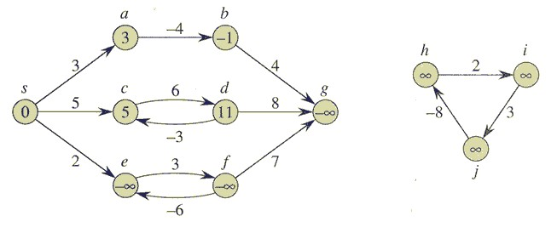
Notes on Shortest-Paths
For single-source shortest-paths problem
  Negative-weight edge and Negative-weight cycle reachable from s No
  A Negative-weight cycle is a cycle with a negative cost
Cycles
  Can a shortest path contain a cycle? No

Slide 5
Property of Shortest Paths
Lemma 24.1 (Sub-paths of shortest paths are shortest paths)
  Given a weighted, directed graph G = (V, E; w), let p = <v₁, v₂, …, v_{k}> be a shortest path from vertex v₁ to vertex v_{k} and, for any i and j such that 1 ≤ i ≤ j ≤ k, let p_{ij} = <v_{i}, v_{i+1}, …, v_{j}> be the sub-path of p from vertex v_{i} to vertex v_{j}. Then, p_{ij} is a shortest path from v_{i} to v_{j}.
  Why?

Slide 6
Relaxation
Relaxation:
  In our shortest-paths problem, we maintain an attribute d[v], which is a shortest-path estimate from source s to v.
  The term RELAXATION is used here for an operation that tightens d[v], or the difference of d[v] and δ(s, v).

Slide 7
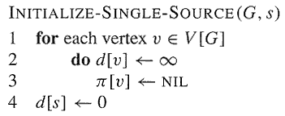
Relaxation--Initialization
The initial estimate of δ(s, v) can be given by:

Slide 8
Relaxation Process
Relaxing an edge (u, v) consists:
  Testing whether we can improve the shortest path to v found so far by going through u, and if so,
  Updating d[v] and π[v].
A relaxation step may either decrease the value of the shortest-path estimate d[v] and update v’s predecessor π[v], or cause no change.

Slide 9
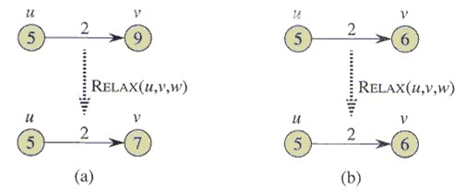
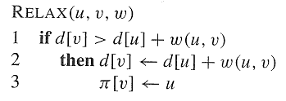
A Relaxation Step

Slide 10
Relaxation
Note:
  All algorithms in this chapter call INITIALIZE-SINGLE-SOURCE and then repeatedly relax edges
  Relaxation is the only means by which shortest-path estimates and predecessors change
  The algorithms differ in how many times they relax each edge and the order in which they relax edges
  Bellman-Ford relaxes each edge many times, while Dijkstra’s and the algorithm for directed acyclic graphs relax each edge exactly once.

Slide 11
Properties of Shortest Paths and Relaxation
Suppose we have already initialized d[] and π[], and the only way used to change their values is relaxation.
Triangle inequality (Lemma 24.10)
  For any edge (u, v) ∈E, we have δ(s, v) ≤ δ(s, u) + w(u, v)
Upper-bound property (Lemma 24.11)
  We always have d[v] ≥ δ(s, v) for all vertices v ∈V, and once d[v] achieves the value δ(s, v), it never changes.
No-path property (Lemma 24.12)
  If there is no path from s to v, then we always have d[v] = δ(s, v) = ∞.

Slide 12
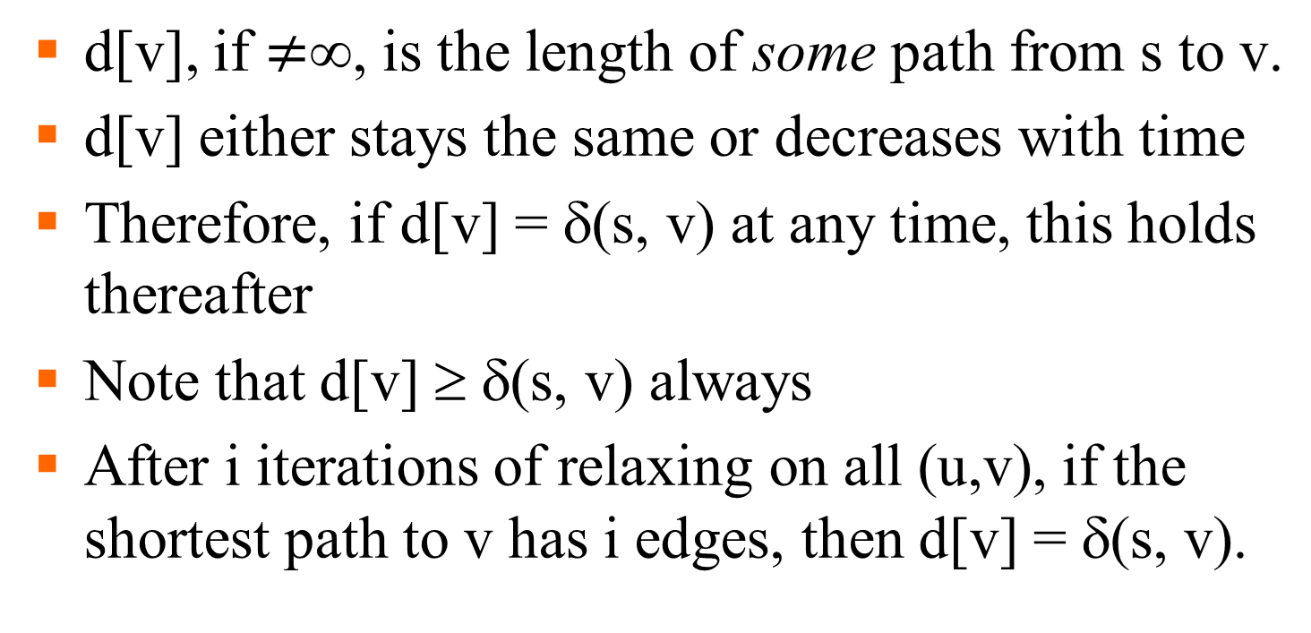
Properties of Relaxation

Slide 13
Properties of Shortest Paths and Relaxation
Convergence property (Lemma 24.14)
  If s ~→ u→ v is a shortest path from s to v in G, and if d[u] = δ(s, u) at any time prior to relaxing edge (u, v), then d[v] = δ(s, v) at all times afterward.
Path-relaxation property (Lemma 24.15)
  If p = <s, v₁, …, v_{k}> is a shortest path from s to v_{k}, and the edges of p are relaxed in the order (s, v₁), (v₁, v₂), …, (v_{k-1}, v_{k}), then after relax all the edges, d[v_{k}] = δ(s, v_{k}).
  Note that other relaxations may take place among these relaxations.

Slide 14
Properties of Shortest Paths and Relaxation
Predecessor-subgraph property (Lemma 24.17)
  Once d[v] = δ(s, v) for all v ∈V, the predecessor sub-graph is a shortest-paths tree rooted at s.
  Predecessor subgraph G_{π} = (V_{π}, E_{π}), where
    V_{π} = {v ∈ V : π[v] ≠ Nil} ∪ {s}
    E_{π} = {(π[v], v) ∈ E : v ∈ V_{π}-{s}}
Note: Proofs for all these properties can be found in your textbook, Page 230-236.

Slide 15
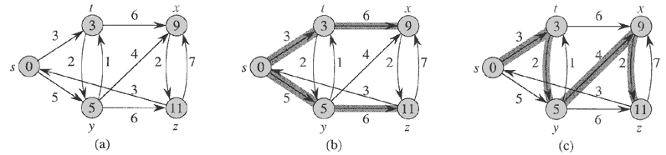
Shortest-Paths Tree
Let G = (V, E) be a weighted, directed graph with source s and weight function w: E→R, and assume that G contains no negative cycles that are reachable from s. A shortest-paths tree rooted at s is a directed sub-graph G’=(V’, E’), where V’⊆V and E’⊆E, such that
  V’ is the set of vertices reachable from s in G,
  G’ forms a rooted tree with root s, and
  For all v ∈V’, the unique simple path from s to v in G’ is a shortest path from s to v in G.
The shortest-path tree may not be unique.

Slide 16
The Bellman-Ford Algorithm
Solve the single-source shortest-paths problem
  The algorithm returns a boolean value indicating whether or not there is a negative-weight cycle that is reachable from the source.
  If there is a negative-weight cycle reachable from the source s, the algorithm indicates that no solution exists.
  If there are no such cycles, the algorithm produces the shortest paths and their weights.

Slide 17
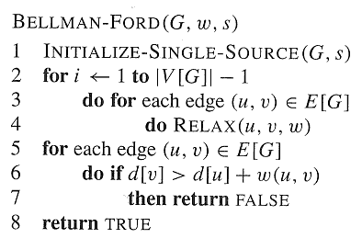
The Bellman-Ford O(VE)-Algorithm

Slide 18
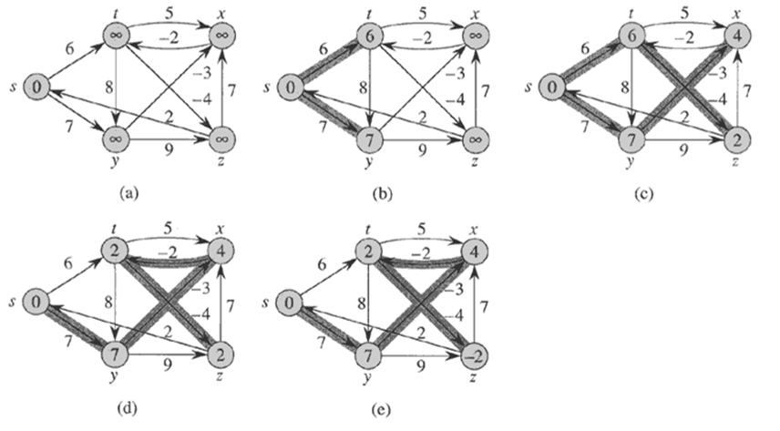
Edges are relaxed in the order: (t, x), (t, y), (t, z), (x, t), (y, x), (y, z), (z, x), (z, s), (s, t), (s, y)
This one is available in our book.

Slide 19
Correctness of The Bellman-Ford
Theorem 24.4
  Let BELLMAN-FORD be run on a weighted, directed graph G = (V, E) with source s and weight function w: E→R. If G contains no negative cycles that are reachable from s, then the algorithm returns TRUE, we have d[v] = δ(s, v) for all vertices v ∈V, and the predecessor sub-graph G_{π} is a shortest-paths tree rooted at s. If G does contain a negative weight cycle reachable from s, then the algorithm returns FALSE.

Slide 20
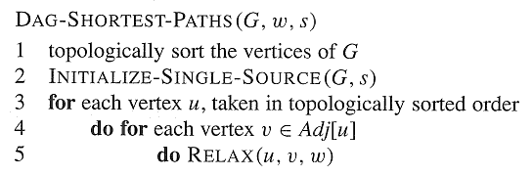
Single-Source Shortest Paths in DAG
Time Complexity: Θ(V + E)

Slide 21
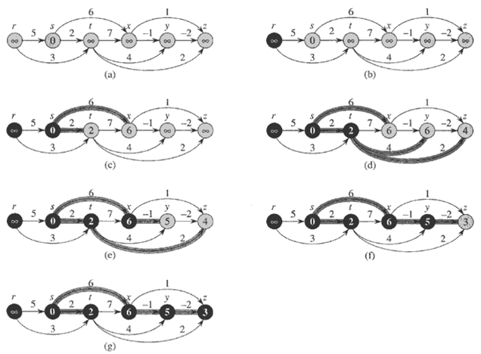

Slide 22
Correctness of the Algorithm
Lemma 24.5
  If a weighted, directed graph G = (V, E) has source vertex s and no cycles, then at the termination of the DAG-SHORTEST-PATHS procedure, d[v] = δ(s, v) for all vertices v ∈V, and the predecessor sub-graph G_{π} is a shortest-paths tree rooted at s.
  Proof. According to path relaxation property.

